Slide 1

MSBA70400: PREDICTIVE ANALYTICS PRESENTATION DIRECT-MAIL FUNDRAISING
TEAM 4
Othiel Glover, Polina Kostylev, Tyler Rathjen, Allison Lynch, Amy Tsang

Slide 2
THE BUSINESS PROBLEM
Problem Background
National Veterans’ Organization
In-house database of over 13 million donors
Overall response rate is 5.1%
Average donation is $13
Cost is $0.68 per mailing
The challenge the firm is facing
Determine a list of targeted advertising donors in order to improve the cost-effectiveness of their direct marketing campaign

Slide 3
DPDA
Decision
Who should we send the fundraising advertisement to
Advantage
Improve the cost-effectiveness of their direct marketing campaign
Maximize expected net profit
Prediction
Targeted advertising based on probability prediction
Data
Large in-house database with historic data and relevant variables available from past donors such as income, demographic data, etc.

Slide 4
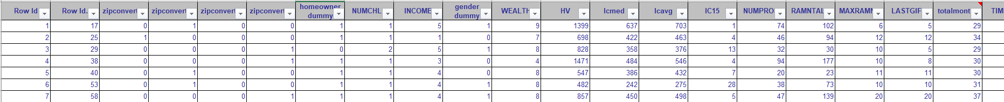
DATA EXPLORATION
Dataset
22 variables
Dependent variable: Target_B – 1 is Donor and 0 is Non-Donor
Donor is underrepresented in the data (rare event)
Used weighted sampling and SAS to solve the rare event
Relevant variables:
Homeowner, Income, Gender, Wealth, Historic Gift Amounts, Average Home Value
Dropped variables:
Converted Zip code with 5 categories (only in Classification Tree)

Slide 5
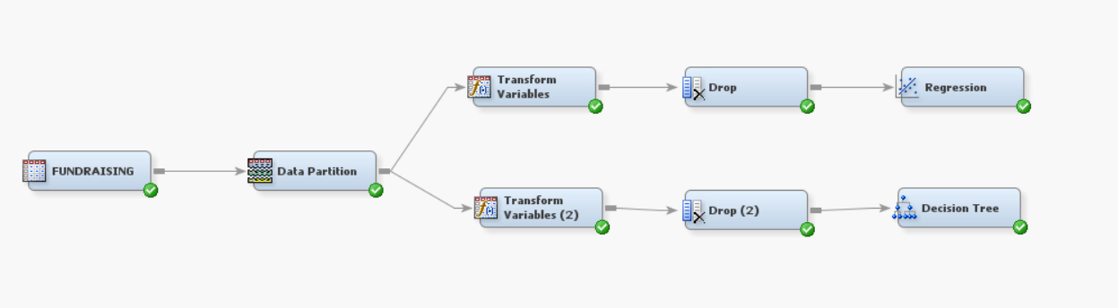
PREDICTIVE TECHNIQUES
Models used:
Logistic regression
Classification Tree
Nearest neighbor – not our event of interest

Slide 6
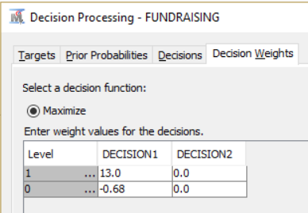
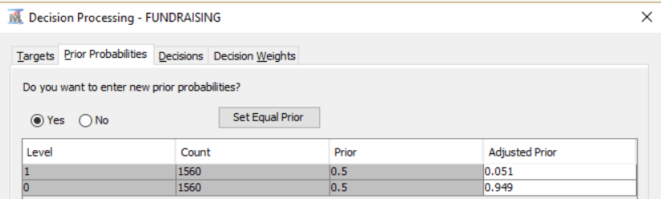
IMPLEMENTATION
Logistic regression
Due to data being oversampled, we needed to adjust the decision weights from 50/50 to the original response rate of 5.1.
Used SAS 9.4 (English) to import via Data Source
Decision Processing:
Selection Criterion: Validation Profit and Loss

Slide 7
RESULTS – LOGISTIC REGRESSION
Performance
Confusion Matrix
Error rate: (293+261)/1248 = 0.444
Decision cut-off:
x($13 profit) + (1-x)(-$0.68 cost) = 0
x = 0.0497
Cost/Benefit:
Decision Rule $4520 vs. Naïve Model $7688
 | Predicted Class (Outcome)
Actual Class (Target) |  | 1 | 0
 | 1 | 363 | 261
 | 0 | 293 | 331

Slide 8
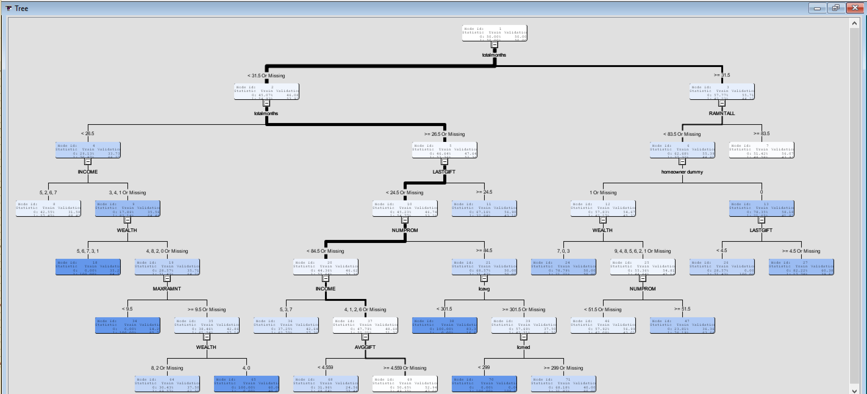
PREDICTIVE TECHNIQUES
Classification Tree (Removed Converted Zip code)

Slide 9
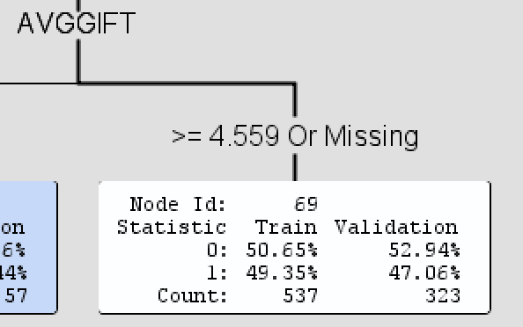
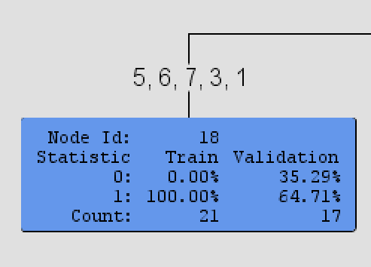
RESULTS – CLASSIFICATION TREE
Early indicators
Significance
if totalmonths < 31.5 AND totalmonths >= 26.5 or MISSING
AND NUMPROM < 84.5 or MISSING
AND LASTGIFT < 24.5 or MISSING
AND INCOME IS ONE OF: 4, 1, 2, 6 or MISSING
AND AVGGIFT >= 4.55903 or MISSING
then
Tree Node Identifier = 69
Number of Observations = 537
Predicted: TI_TARGET_B1=1 = 0.49
Predicted: TI_TARGET_B1=0 = 0.51
Effectiveness
if totalmonths < 26.5
AND WEALTH IS ONE OF: 5, 6, 7, 3, 1
AND INCOME IS ONE OF: 3, 4, 1 or MISSING
then
Tree Node Identifier = 18
Number of Observations = 21
Predicted: TI_TARGET_B1=1 = 1.00
Predicted: TI_TARGET_B1=0 = 0.00

Slide 10
INSIGHTS
Logistic Regression:
Naïve Model is more profitable than decision rule (logistic regression)
Naïve $7688 > Decision Rule $4520
Low cost $0.68
High donation average $13
Classification Tree
Top indicator: AVGGIFT >= 4.55903
Next Step:
What if the average donation is lower than $13?

